Slide 1
Cloud infrastructure designed for a sustainable future
Notes:
As global technology demands surge, our reach and scale position us to lead meaningful climate action. AWS is transforming cloud infrastructure to meet tomorrow's needs.

Slide 2
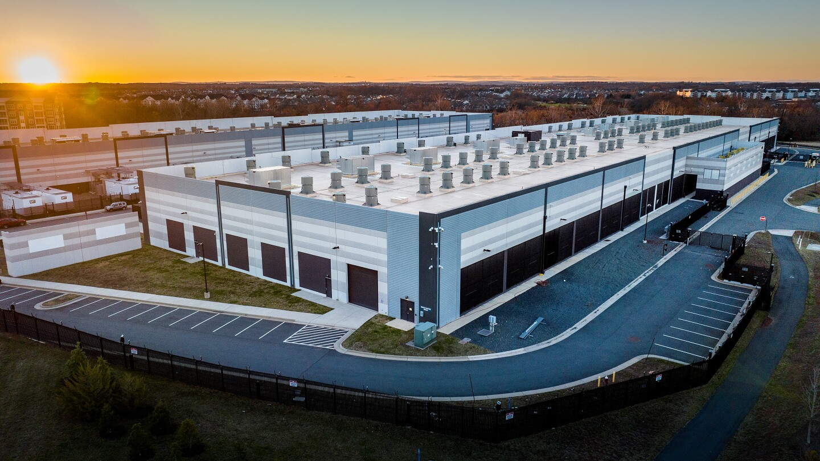

Investments in 600+ wind and solar projects
Amazon is the largest corporate purchaser of renewable energy globally, 5 years running, according to BloombergNEF
Amazon’s progress:
Net-Zero carbon by 2040
In 2024, Amazon signed 4 nuclear agreements
We match 100% of the electricity consumed by our global operations with renewable energy sources
© 2025, Amazon Web Services, Inc. or its affiliates. All rights reserved
Notes:
Invested in 600+ wind and solar projects
Amazon is the largest corporate purchaser of renewable energy globally for the fifth year in a row, according to Bloomberg NEF
In 2024, Amazon signed 4 nuclear agreements, expanding our investments in carbon-free energy
100% of the electricity use in our global operations was matched by renewable energy in 2024, for the 2nd consecutive year
How is AWS contributing to Amazon’s companywide net-zero carbon goal by 2040?

Slide 3

New AWS data center design
Enhanced efficiency for tomorrow’s AI workloads
Optimizing data center design
46% reduced mechanical energy
35% less embodied carbon in concrete used
PUE is one way we measure the efficiency of our data center operations. A lower PUE indicates a more efficient data center and a PUE score of 1.0 is perfect.
Source: About Amazon: AWS Announces New Data Center Components to Support AI Innovation and Further Improve Energy Efficiency
Notes:
Today, in virtually every corner of the company, we’re using generative AI to make customers’ lives better and easier. One of the biggest challenges with scaling AI is increased energy demands for data centers. We are laser-focused on improving energy efficiency, which we measure through Power Usage Effectiveness (PUE).
In 2024, AWS data centers had a global PUE of 1.15—better than both the public cloud industry average of 1.25 and 1.63 for on-premises enterprise data centers (as estimated by IDC).
Our best performing site was in Europe with a PUE of 1.04.
A lower PUE value indicates greater efficiency (with the theoretical minimum PUE being 1.0), and indicates that using AWS to power AI innovation is a lower-emission option than most.
A large contributing factor is our optimized data center design, including components that deliver 12% more computing power and reduce peak cooling energy consumption by 46% compared to previous designs, all without increasing water usage.
35% less embodied carbon in concrete used: AWS design standards now require concrete with a 35% reduction in embodied carbon compared with standard concrete for new U.S. data centers, and we are expanding this requirement globally.
46% reduced mechanical energy: Efficient cooling system in our new data center design is expected to reduce mechanical energy by up to 46%.

Slide 4
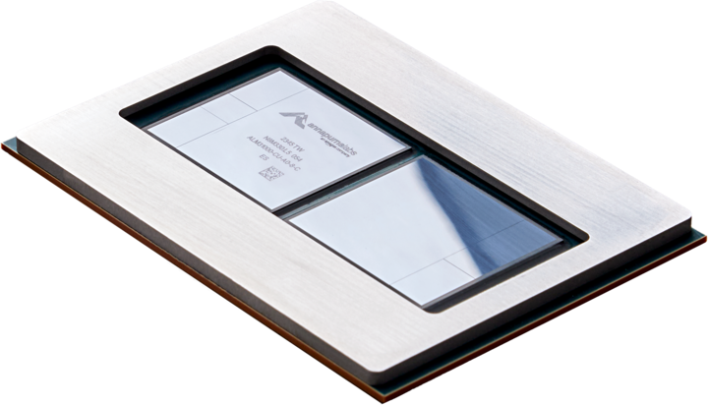
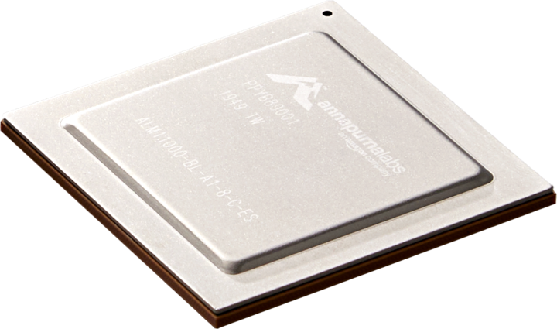

Accelerate cloud optimization with AWS silicon
Leverage AWS chips to run workloads sustainably
AWS Graviton
AWS Graviton-based Elastic Compute Cloud instances use up to 60% less energy than comparable Amazon EC2 instances
AWS Inferentia
AWS Inferentia chips are designed to deliver high performance at the lowest cost in Amazon EC2 for deep learning and generative AI inference applications
Notes:
We offer a number of chips with energy-efficiency benefits. For example, Graviton-baed instances use up to 60% less energy than coparable instances for the same performance. Over 70,000 customers have used AWS Graviton to build efficient and performance workloads.
AWS Inferentia, our AI inference chip, is also built for sustainability. Our latest Inferentia2 AI chip delivers up to 50% higher performance per watt and can reduce costs by up to 40% against comparable instances.

Slide 5
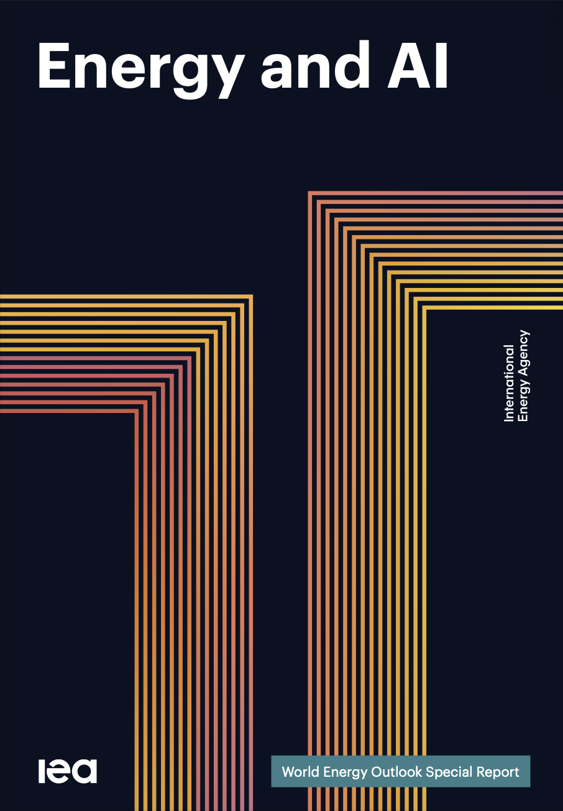
“The energy sector is at the heart of one of the most important technological revolutions today. “
Global data-centre electricity use will more than double from 415 TWh (2024) to 945-1200 TWh (2030)
AI workloads drive ~50% of incremental data-centre demand; AI clusters consume 10–20× more power per rack than traditional servers.
AI could unlock 175 GW of additional transmission capacity via optimisation — without building new lines and can reduce total energy-sector CO₂ emissions by 3–5%
AI-driven optimization can save 3x more energy than it uses.
5
Notes:
Global data-centre electricity use will more than double from 415 TWh (2024) to 945-1200 TWh (2030)
Massive increase in procurement volume, regional exposure, and grid interconnection risk. Need to diversify energy mix and anticipate new load clusters.
AI and cloud workloads surge; AWS’s compute expansion directly tied to power availability and carbon footprint. Growth ceiling set by energy access.
AI workloads drive ~50% of incremental data-centre demand; AI clusters consume 10–20× more power per rack than traditional servers.
Must evolve sourcing to handle higher density loads (e.g., microgrids, SMRs, long-duration storage). Stronger partnership with Data Center Design & Construction.
AI services (Bedrock, Trainium, Inferentia) and customer GenAI usage accelerate — energy is now a competitive constraint.
AI could unlock 175 GW of additional transmission capacity via optimisation — without building new lines and can reduce total energy-sector CO₂ emissions by 3–5%
Elevates importance of long-term PPAs, local permitting relationships, and on-site generation. Every siting decision has political and social visibility. Public perception of “AI’s energy appetite” could affect AWS brand; transparency and renewable progress build trust with customers and regulators.
AI-driven optimization can save 3x more energy than it uses.

